Slide 1


CLONE WEBSITE
Name:
M. Padma Praharshitha
ON
SkillsBuild EnailID
praharshitha210@gmail.com
College Name
Maharaj Vijayaram Gajapathi Raj College pf Engineering
Amazon Online
Shopping Plaform
College
State
Andhra pradesh
Internship Domain
Front-end Development
Start Date:
12-06-2023
Student Details
End Date:
24-07-2023

Slide 2

Problem Statement
To develop an amazon clone to make an engaging, intuitive and user friendly website using web technologies.

Slide 3

AGENDA
The main objective of this project is to create a fully functional amazon website clone, which showcases the design and functionality of the popular e-commerce platform. It should prove a simulated shopping experience for users

Slide 4
PROJECT OVERVIEW
The main goal of this project is to create a functional clone website with a scope in the future, for further development. Amazon is a very popular e-commerce website, whose clone can be used to enhance the features for futuristic developments and set of trials and tests.

Slide 5

END USERS
PRIMARY END-USERS
Online shoppers looking for a wide range of products, are the first ones to use this website
SECONDARY END-USERS
Potential sellers and merchants comes under secondary users, who are interested in this platform.

Slide 6

AMAZON CLONE
Soultions & Value Propositions
SOLUTIONS
VALUE PROPOSITIONS
Intuitive design for easy navigation
Simple and clear product categorization
AI-driven product recommendations
Social Integration
Side-by-side product feature comparison
A vast array of products across diverse categories to cater to all needs
Partnerships with reliable logistics providers for timely shipment
Multiple channels for prompt query resolution and assistance.

Slide 7

Unique Branding and Identity: Tailor the platform's design and logo to create a distinct brand image.
Seamless User Experience: Intuitive and user-friendly interface for easy navigation
Curated Product Selection: Carefully select top-quality products to ensure customer satisfaction.
Social Media Integration: Share products and deals on social platforms for increased visibility.
Customization of the project

Slide 8

MODELING
Web Technologies like HTML and CSS are used in order to develop this clone project. This project was made as simple as possible , to showcase the easiness and felxibility of the project.
This project can be further endured and developed with the help of advanced web technologies like reactJS, nodeJS, and other databases like MongoDB

Slide 9
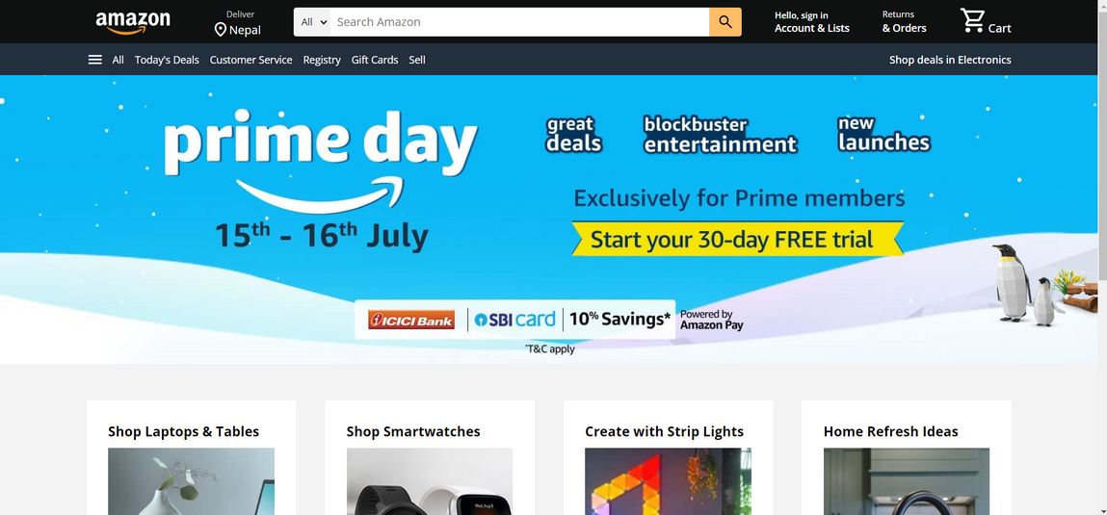
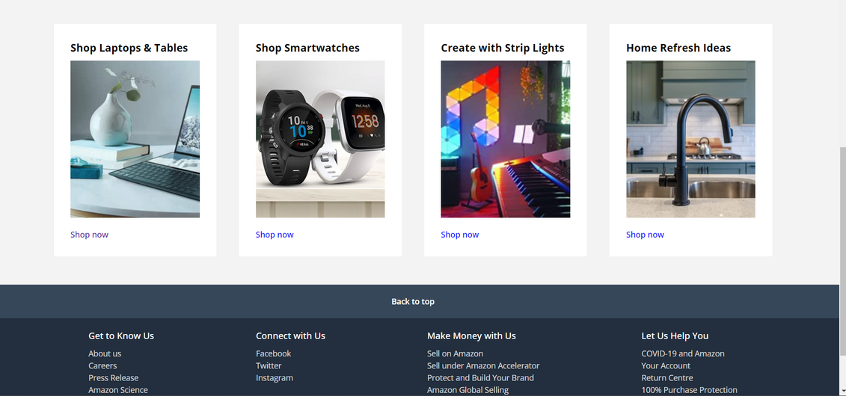
RESULT
USER ADOPTION
INTUITIVE INTERFACE
WEBSITE PERFORMANCE
PRODUCT SELECTION
AI DRIVEN TECH
CUSTOMAER FEEDBACK

Slide 10
REFERENCE
https://github.com/Harshu210/amazon_clone.git

